Slide 1





School: ............................................................................................................. Campus: .......................................................
Academic Year: ...................... Subject Name: ........................................................... Subject Code: ..........................
Semester: ............... Program: ........................................ Branch: ......................... Specialization: .......................... Date: .....................................
(Learning by Doing and Discovery)
* Coding Phase: Pseudo Code / Flow Chart / Algorithm
ALGORITHM:
Connect to the blockchain network.
Retrieve the latest block data.
Traverse blocks using previous hash links.
Extract and read transactions from each block.
Verify transactions using Merkle tree.
Validate block integrity and consensus.
Analyze and display blockchain data.
* Softwares used
Brave Web Browser
Blockchain Explorer Website

Slide 2
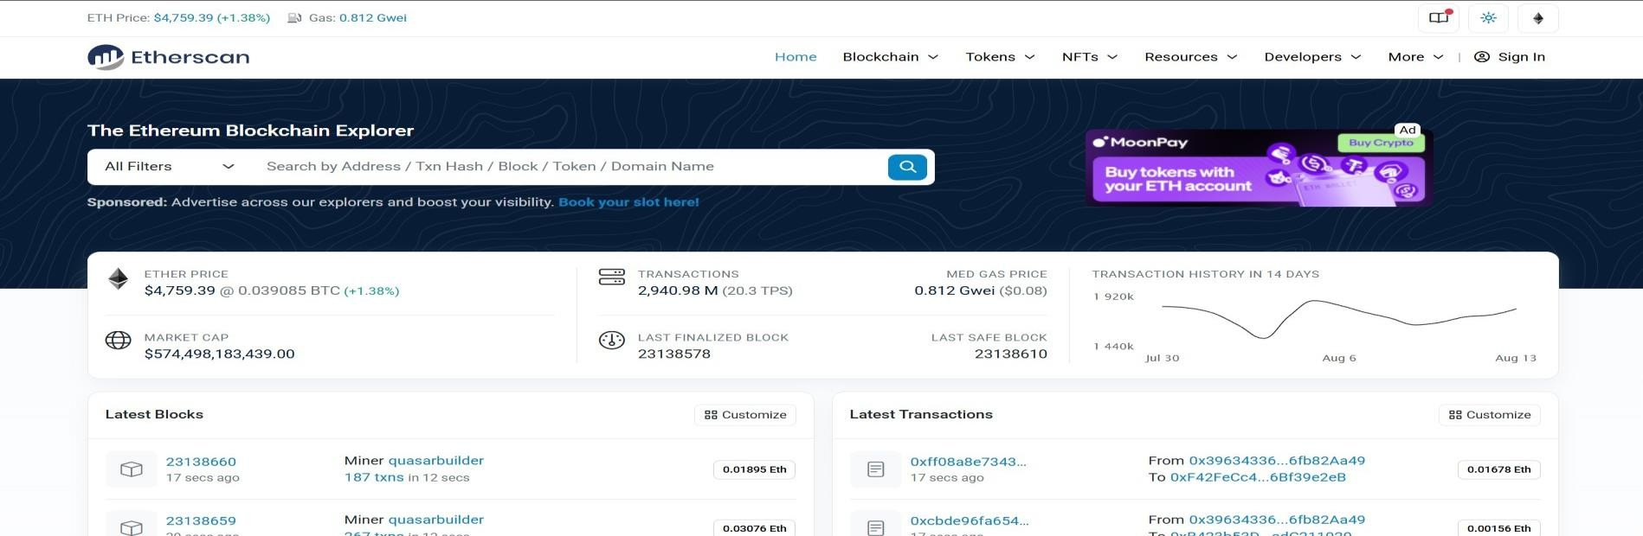

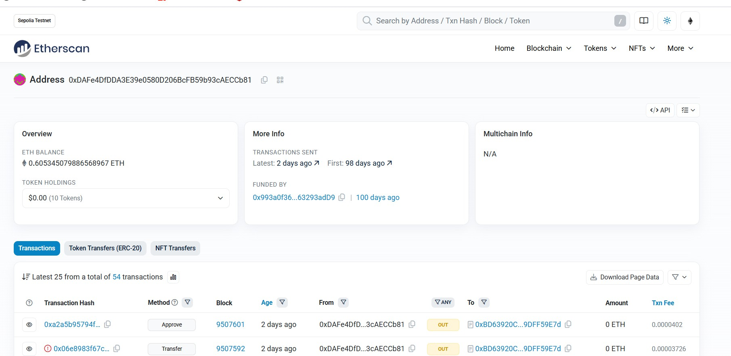
Applied and Action Learning
* Implementation Phase: Final Output (no error)
First open the bitcoin explorer- https://www.blockchain.com/explorer
Then in search bar you can search with address,TXID and Token name
After searching will able to see the all details about the transaction like hash,timestamp,status,block
number,value ,gas price etc.

Slide 3
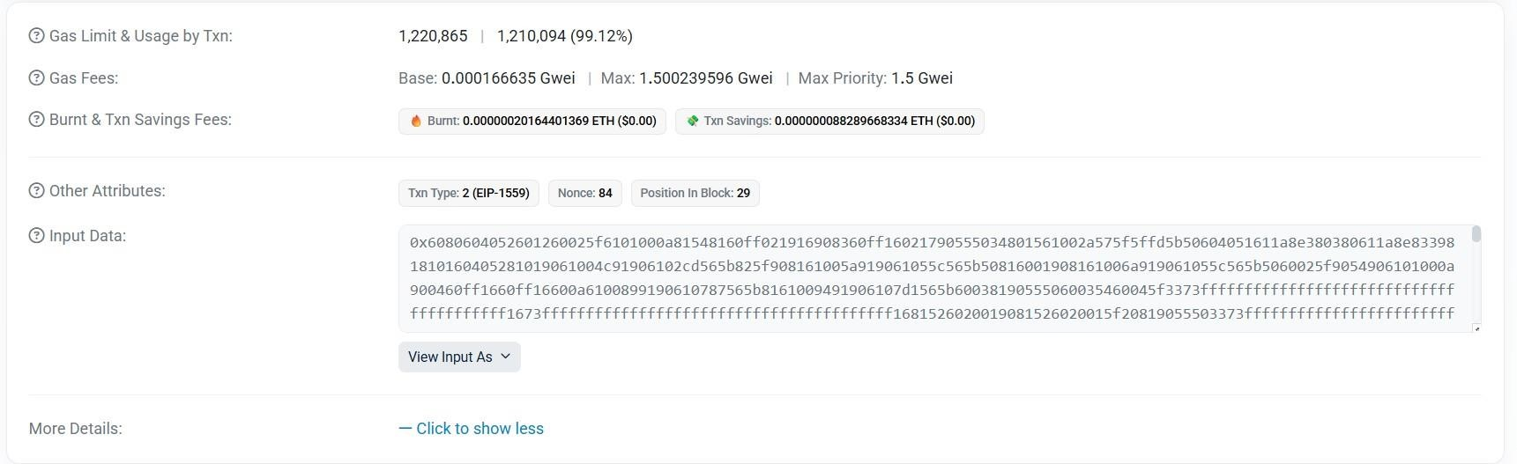

* Implementation Phase: Final Output (no error)
Applied and Action Learning
Now you can see all the details of the transactions on a blockchain explorer
* Observations
Each block is securely linked to the previous one through cryptographic hashes.
The blockchain ensures data transparency and immutability and transactions can be traced but no altered once confirmed.
Inputs and outputs were clearly listed, showing how Bitcoin was spent from one address and sent to one
or more recipients.
Rubrics
Concept | 10
Planning and Execution/ Practical Simulation/ Programming | 10
Result and Interpretation | 10
Record of Applied and Action Learning | 10
Viva | 10
Total | 50
Signature of the Student:

